Slide 1
ChemCorp – Non Technical Presentation
Date: 22nd November 2020
Presenter: Shichy Seanan

Slide 2
Southern Water Corp Problem Analysis?
!
Through the increased demand for desalinated water, the machines are made to work overtime without any halt hours for the machine to cool down
Problem 1
Increased demand leading to increased pump wear
!
Problem 2
Increased maintenance period
Due to increased maintenance period which decreases the output & supply in turn increases the cost to produce & demand

Slide 3
Pump Analysis
Key Insights
Overarching Insight
Probability of failure has increased due to overuse of the pumps
Support Point 1
Some of them have shown wear & tear
Support Point 2
Pumps have been used to support with demand for increased water supply

Slide 4
There are two types of statistical approaches we had covered
<SMART PROBLEM STATEMENT>
Inorder, to stay within the market we have to research the competitors products on what they are providing unique
To fulfil the demand of the clients we need to come up with new ways to deliver products

Slide 5
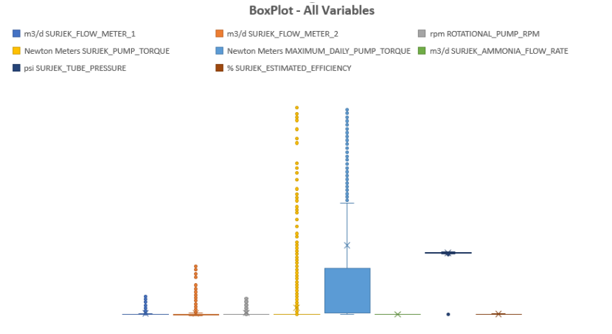
Descriptive Statistics Analysis
Key Insights
Form the insights we can conclude that some of the pumps have more wear & tear than others we have to improve these locations first & invest more on these areas rather than investing more on others as they still will function the same.
These will work on the same amount of execution time as the other pumps will

Slide 6
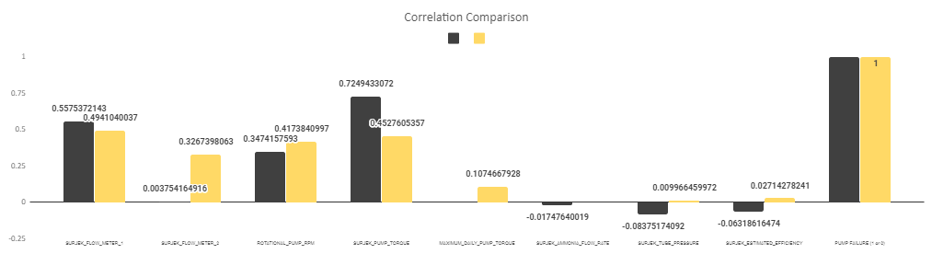
What have we concluded from our Inferential statistics analysis
Key Insights
Some of the correlation data are different from the original data
As the pumps have enough wear & tear instead of making them work overtime we can make them switch off for a while.
Buying newer pumps will save us the enough hassle we have right now

